Slide 1


goAML Validation

Slide 2
Challenges
Effective 1st February, NFIU migrated their report-checking business rules from the goAML client to the goAML schema using XSD assertions.
This means validation now happens at the schema level rather than after submission.

Slide 3
Challenges
For Reporting Entities, this means fewer post-submission rejections by NFIU but significantly more reports failing validation at the point of upload when they don't meet schema requirements.

Slide 4
Challenges
NFIU launched with approximately 15 assertion-based rejection rules and has since added 16 more.
Additional rules are being introduced as NFIU sees fit, without prior notification. Each addition increases the likelihood of validation failures for non-compliant reports.

Slide 5
Challenges
The fast-moving updates introduces a real pain point for Reporting Entities, particularly when triaging failures is difficult.
The current goAML online and offline validators do not comprehensively identify or explain the specific issues causing failures.

Slide 6
goAML Validator
Core Features

Slide 7
On-System Deployment & Data Privacy
The Validator runs entirely on the Reporting Entity's own machine.
  Data never leaves your network
  Local Validations only
  Zero Log retention
  Designed with highest Security Levels

Slide 8
Schema-Driven Validation
Validation rules are defined in a goAML XSD schema file, not hardcoded into the application. Providing for a flexibility that works with this fast-paced environment
  XSD schema managed by Keyrium
  Application fetches new XSD via Sync
  No application update required

Slide 9
Automatic goAML Schema Sync
Connect directly to the goAML portal using your institution's own credentials and securely pulls the latest XSD schema automatically.
A notification banner alerts you when the active schema is more than 7 days old, prompting a sync before the next submission cycle.

Slide 10
Enumeration Code Reference
A built-in searchable reference panel lists every valid enumeration code and provides descriptions.
Values are read directly from the active schema, so the reference is always consistent with the validation rules in use.
Account Types
Transaction Modes
Currency Codes
Country Codes
Funds Types
etc

Slide 11
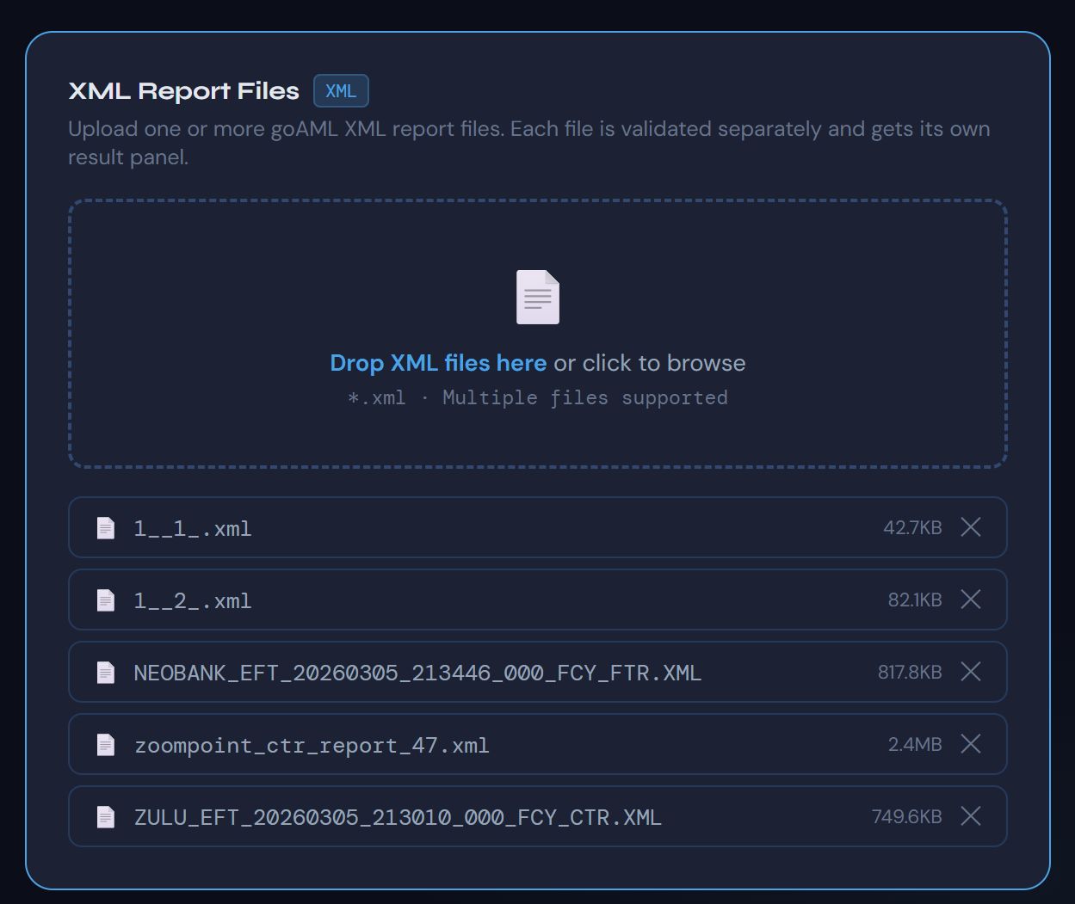
Batch Validation
Our Solution supports multiple XML report files validation in a single session.
Results are organized per file with full error details including structural/formatting errors, assert rejection codes (REJ code), transaction number, line number, the offending value, and plain-English description of what failed.

Slide 12
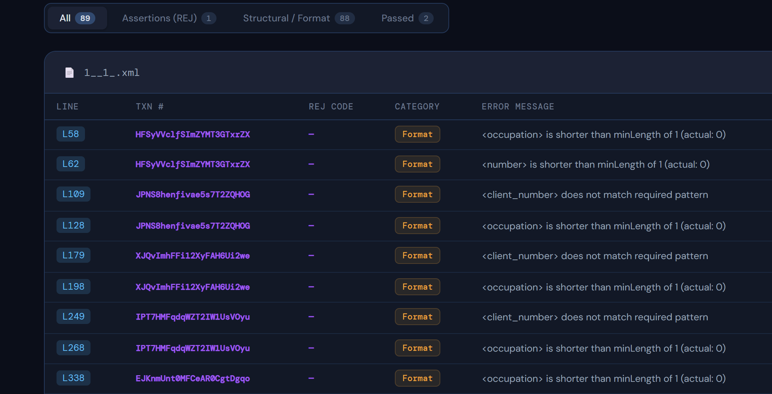
Actionable Error Reporting Tool
Each validation error includes everything needed to locate and fix the problem
Specific REJ rule violated.
Transaction number
Line number in the file
Exact value that triggered the error.
Error category.
Results can be exported to CSV or JSON for review in Excel or other tools.

Slide 13
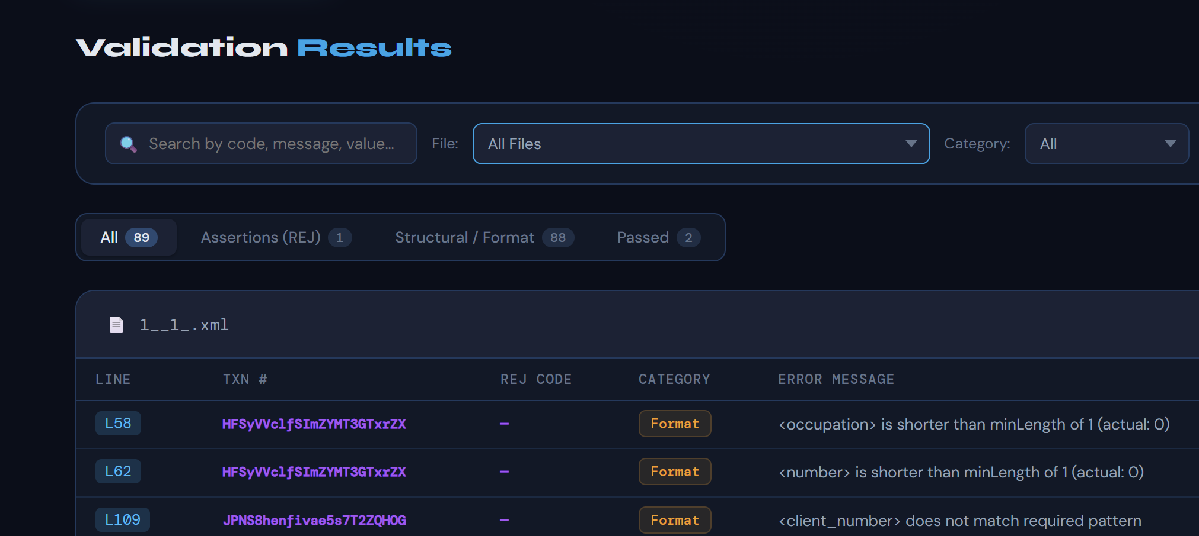
Sortable & Filterable Results
Output result table support column-level filtering by REJ code and category.
Global search across all results.
One-click sorting
Line number
Transaction number
REJ code
Category
Large submission files with hundreds of errors are triaged efficiently.

Slide 14
Submission Rejection Prevention
By catching structural errors, business rule violations, and invalid enumeration values before submission, the application eliminates the back-and-forth of rejected goAML reports.
Reporting entities submit with confidence, and compliance officers can track error patterns across submission cycles.

Slide 15
Pricing

Slide 16
License Model
We provide various License models to suit the current needs of your institution.
All subscriptions come with unlimited updates (schema and software)
Package | Target | One-Time Implementation Cost | Units | Support Channels
Enterprise | Large commercial banks | ₦3,500,000 - ₦5,000,000 | 15 | In-Person Email Phone
Gold | Mid-size banks | ₦2,500,000 - ₦3,000,000 | 7 | Email Phone
Silver | Microfinance / smaller institutions | ₦1,000,000 - ₦1,500,000 | 3 | Email
Customised (eg, integration with your AML/CFT solution) |  | Contact Us

Slide 17
Service Level Agreement
Package | Annual Maintainance Fee
Enterprise | ₦1,500,000
Gold | ₦1,000,000
Silver | ₦600,000
Customised (eg, integration with your AML/CFT solution) | Contact Us
Starts in Year 2 and covers the following
Updates (XSD Schemas, Core Software Package)
Bug fixes
Support (based on plan)
Usage authorization

Slide 18
Thank you
Michael Mgbeahurike
+234 90670 87649
michael@keyriumconsulting.com
www.keyriumconsulting.com

